Slide 1
PWM
May, 2017

Slide 2
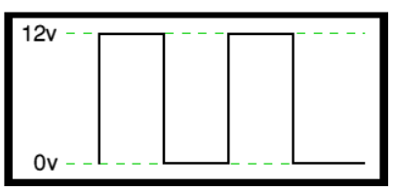
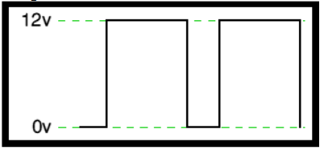
PWM
PWM (Pulse width modulation) - powerful technique for controlling analog circuits with a microprocessor's digital outputs.
½ of the total voltage => 6V
¾ of the total voltage => 9V

Slide 3
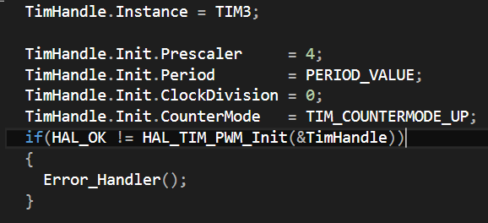
PWM
Configure hardware timer – hardware timers can count from 0 to a given value, which can trigger events in between.
Prescaler = 4 - specifies the prescaler value used to divide the TIM clock
Period = 1800 - to have an output frequency equal to ~10 KHz, period ~100us
ClockDivision = 0 – to be seen in datasheet, page 515 and page 559
Counter direction = Up
Notes:
In the PWM mode the timer controls the output of 1 or more output channels. When the counter value reaches 0, maximum or a compare value defined for each channel, the output value of the channel can be changed. Various configuration options define which events change the value and how it is changed.

Slide 4
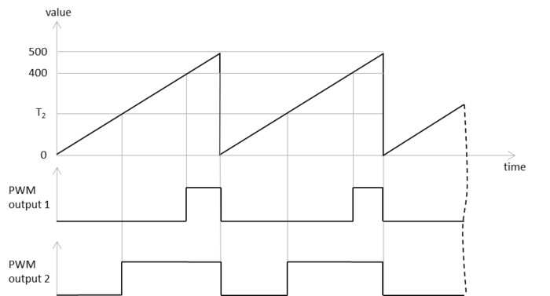
PWM

Slide 5

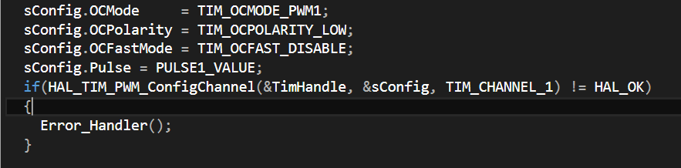
PWM
2) Configure the PWM channels – after Timer configuration

Slide 6
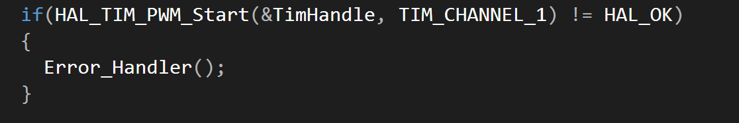
PWM
After each change of PWM Pulse (sConfig.Pulse call this function!

Slide 7
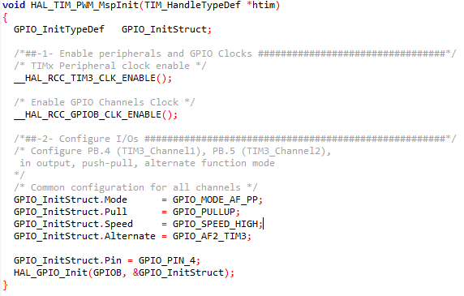
PWM
3) Configure GPIO PINS – this function is called from stm32f4xx_hal_tim.c
and it is implemented in stm32f4xx_hal_msp.c

